Slide 1
Improving Immediate Use of Postpartum LARCs
William M. Sappenfield, MD, MPH, CPH
Director, Florida Perinatal Quality Collaborative
The Chiles Center at the College of Public Health
University of South Florida

Slide 2
Vision
“All of Florida’s mothers and infants will have the best health outcomes possible through receiving high quality evidence-based perinatal care.”
Values
Voluntary
Population-Based
Data-Driven
Evidence-Based
Value Added
Notes:
Blue looks fine!

Slide 3
FPQC Partners and Funders
Florida Chapter March of Dimes
Florida Department of Health
Agency for Health Care Administration
Florida Hospital Association
Florida Blue
ACOG District XII
Florida Society of Neonatologists/FCAAP
Florida Council of Nurse Midwives
AWHONN
Preeclampsia Foundation
Florida Association of Healthy Start Coalitions
Council on Patient Safety in Women’s Health Care
Notes:
1) and 2) Finer and Zolna, see comment
3) Baldwin, M. K., & Edelman, A. B. (2013). The effect of long-acting reversible contraception on rapid repeat pregnancy in adolescents: a review. Journal of Adolescent Health, 52(4), S47-S53.
4) Conde-Agudelo, A., Rosas-Bermúdez, A., & Kafury-Goeta, A. C. (2006). Birth spacing and risk of adverse perinatal outcomes: a meta-analysis. Jama, 295(15), 1809-1823.

Slide 4
FPQC Initiatives
Infant Health
Maternal Health
2011
Neonatal Catheter Infection
Early Elective Delivery
2013
Obstetrical Hemorrhage
Golden Hour
2015
Antenatal Steroids
Mother’s Own Milk
Perinatal Indicator Reporting
Hypertension
2017

Slide 5
Upcoming Project: Immediate Postpartum Long-Acting Reversible Contraception (pLARC)

Slide 6
LARC Background
In 2011, 45% of pregnancies in the U.S. were unintended; Florida’s rate was 59% in 2010
Women <30 years old account for the largest number of unintended pregnancies
Nearly 35% of pregnant teens experience another pregnancy in 2 years (rapid repeat)
Women with a repeat pregnancy in 5-17 months are at increased risk of poor pregnancy outcomes
Notes:
1) and 2) Finer and Zolna, see comment
3) Baldwin, M. K., & Edelman, A. B. (2013). The effect of long-acting reversible contraception on rapid repeat pregnancy in adolescents: a review. Journal of Adolescent Health, 52(4), S47-S53.
4) Conde-Agudelo, A., Rosas-Bermúdez, A., & Kafury-Goeta, A. C. (2006). Birth spacing and risk of adverse perinatal outcomes: a meta-analysis. Jama, 295(15), 1809-1823.

Slide 7
Pregnancy Outcomes
Unintended / closely spaced pregnancies contribute to:
Delayed initiation of prenatal care
Higher risk of preterm birth & small for age
Higher risk of maternal depression & child neglect
Lower breastfeeding rates
LARC—intrauterine devices (IUD) & progesterone implants—are safe & highly effective prevention

Slide 8
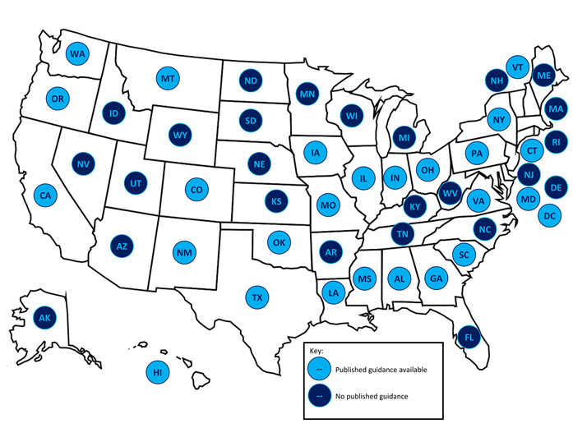
States with Medicaid Guidance for Immediate Postpartum LARC
Notes:
ACOG Bulletin

Slide 9
Why Immediate Postpartum LARC?
Immediate is within 10 minutes of placenta delivery
Women are already in the hospital accessing healthcare
They are motivated to obtain contraception
Up to 40% of patients do not return for 6 week postpartum visit

Slide 10
Postpartum LARC Barriers
Patients
Providers
Lack of knowledge about postpartum options
Misperceptions about side effects
Restrictions by insurance
Concern about impact on postpartum milk supply
Lack of knowledge, training & comfort
Providers deter patients from using LARCs
Not an option in delivering facility
Lack of reimbursement

Slide 11
pLARC Advisory Team
Rachel Rapkin, MD, LARC Advisory Group Chair, USF
Betsy Wood, FPQC Nurse Consultant
Julie DeCesare, Residency Director, UF Pensacola
Eina G. Fishman, MD, Chief Medical Officer, United Health Care
Robert Yelverton, MD, ACOG District XII and Women’s Care FL
Pam Schwartz, MD, OB Hospitalist
Candace L. Rouse, DNP, RN-C, CNS-BC, UF
Kay Roussos-Ross, MD, UF
Brad Bruggeman, MD, UF
Angela Windom O’Donnell, Women’s Health Care Midwives
Dianne Cosgrove, Florida Hospital Association
Karla Maguire, MD, UM Jackson Memorial
Marilyn W. Fudge, MD, MHA, Bayfront Health
Faye Johnson, Executive Director, Northeast Florida Healthy Start Coalition
Maria Diaz, MD, Chair, ACOG XII Committee on Health Care for Underserved Women & Aetna
Cathy Timuta, Executive Director, Healthy Start of Southwest FL
Elicia Coley, AHCA
Janicka Harris, AHCA
Susan Speake, FL DOH Title X program director & family planning program administrator

Slide 12
Florida OB/Gyn Residency Program Joint Quality Improvement Project
Purpose: To add immediate postpartum LARC as a feasible contraception option in training programs.
All 8 Florida Obstetrics/Gynecology residency programs have agreed this LARC initiative will be their joint residency QI initiative
4 of the 8 institutions are participating on the initiative advisory group

Slide 13
pLARC Project Projected Timeline
Hospital Recruitment
Individual Hospital Kick-Offs
“Pre-Implementation”
Mid-Project Meeting
“Implementation”
August – September 2017
January 2018
Fall 2018
State Initiative Kick-Off
Initiative Completion
November 2017
March 2019
1978
2017
2018
2019
2015
Today
Monthly Learning Sessions
Ongoing Data Collection
Onsite TA Visits
Technical Assistance Upon Request
Baseline Data Collection
Recruit Leadership Team
October - December 2017
February 2018 – January 2019

Slide 14
pLARC Toolkit Outline
Introduction Background/ How to use toolkit / Implementation Suggestions / Key Recommendations List
Provider/Staff Education
Ability to offer it immediately postpartum and why
Technical education on insertion
Counseling patients
Establishing billing codes/reimbursement procedures
Developing pharmacy procedures to stock LARC
Policies and Procedures for immediate pLARC
Establish order sets
Establish consent process
Educate and Counsel Patients
Prenatal
Intrapartum
Postpartum
Appendices – Sample tools

Slide 15
Draft Project Element Pre-Implementation Phase: Months 1-6
Gain administrative support and infrastructure
Develop targeted education for key internal audiences
Administration
OB, nursing, clinic, billing, pharmacy leadership
Midwives
Lactation consultants
Establish billing procedures
Coding
Reimbursement
Develop pharmacy procedures
Inventory
Where stocked
Order sets

Slide 16
Draft Preliminary Project Elements Implementation Phase: Months 3-18
Develop policies and procedures for insertions
Provide staff & clinician education on pLARC insertion
Develop counseling/consent process
Timing and location
Roles/responsibilities for supplies
Documentation process
Identification of women requesting pLARC insertion
Develop process integrating pLARC insertion into usual operations of labor/delivery, postpartum floor
Integrate pLARC insertion into EMR
Develop patient education on pLARC insertion
Provide education for all prenatal care providers

Slide 17
Proposed Pre-Implementation Activities
Action | Timeframe | Activity | Output/Product
Obtain Administration Support | Months 1-3 | Identify Champions Hospital Administration Pharmacy Billing/Finance Physician/Provider MCO Nursing/L&D Clinic (if applicable) Lactation Consultants Develop strategy/tools for gaining buy in from key departments/champions Provide targeted education to pharmacy, billing leaders on value of pLARC Identify barriers to implementation | List of Champions Strategy identified Speaking points/fact sheets developed Specific educational presentations developed List of barriers and possible solutions
Create billing mechanism | Months 2-6 | Meet with MCOs to identify Medicaid and insurance coding and billing specifications Identify steps to capture necessary data elements Identify barriers to implementation | List of codes and billing specifications Coding algorithm List of barriers and possible solutions
Create inpatient LARC pharmacy capacity | Months 3-6 | Develop pharmacy procedures for: Ordering LARCs Stocking/storing LARCs Inventorying LARCs Create order sets/billing forms for providers Identify barriers to implementation | Comprehensive pharmacy procedures Order sets/billing forms List of barriers and possible solutions

Slide 18
Session Topics
South Carolina Birth Outcomes Initiative: Actions & Results for LARC and Immediate Postpartum
Co-Producing Care with Patients and Families
Antibiotic Stewardship
Neonatal Abstinence Syndrome
Ethnic Disparities Bundle
Perinatal QI Indicators
Supporting Vaginal Birth: Skills for Nurses
Hypertension in Pregnancy
State of the FPQC
Empowering Patients from Hospital to Home
Human Milk Feedings for Premature Infants with Implications for Donor Human Milk Use
Zika: What We Know and What We Don’t Know
Challenges with the Periviable Infant
Mother’s Own Milk
Long Acting Reversible Contraceptives

Slide 19
Plenary Speakers:
Paula Meier, PhD, RN, FAAN
Maren Batalden, MD, MPH
Heather Barrow, MA
BZ Giese, BSN, RN
Sonja A. Rasmussen, MD, MS

Slide 20
Questions
www.fpqc.org
fpqc@health.usf.edu

