Slide 1
Performance Improvement Projects (PIP): Challenges, Successes & Sharing Best Practices External Quality Review Meeting February 2, 2016
Megan Thompson, MSW
Bureau of Medicaid Quality
Agency for Health Care Administration

Slide 2
In this presentation:
1. Refresher: Performance Improvement Projects
2. Findings from AHCA Dental PIP Reviews
3. Challenges
4. Successes
6. A look at other states

Slide 3
Refresher! Performance Improvement Projects
What are PIPs?
Quality improvement projects that typically consist of a baseline, intervention period and remeasurement.

Slide 4
Refresher! PIPs: What is the Goal?
‘PIPs shall achieve, through ongoing measurements and intervention:
Significant improvement to the quality of care and service delivery, sustained over time, in areas that are expected to have favorable effect on health outcomes and enrollee satisfaction.’
Source: AHCA MMA Plan Contract

Slide 5
Refresher! PIPs: Considerations
Who conducts PIPs?
Health Plans
Providers
States
EQROs
Why undertake a PIP?
To address a concern or problem
It is required by contract
It is required by federal CMS
Questions to ask yourself:
What is your market size and geography?
What is the composition of the market?
What are your current quality improvement initiatives?
And historic initiatives?
What has your past performance been? Did we identify barriers previously?
What is your goal? Make a goal that is both meaningful and obtainable.
What objectives will help you meet your goal(s)?Objectives are typically more specific and measureable.

Slide 6
Refresher! The PIP Process
PIPs provide AHCA and CMS a tool to appreciate and understand your work.

Slide 7
AHCA Dental PIP Analysis
-Designated Quality Bureau staff have been reviewing all PIPs and validation reports.
-Findings have been compiled into a spreadsheet
-PIP Check-Ins will soon begin (Marie Donnelly, Quality Bureau Chief will provide more details)
-Will focus on PIP for Preventive Dental first

Slide 8
Dental: MMA Program Quality:
Dental Visit Scores 08/01/2014--07/31/2015
https://bi.ahca.myflorida.com/t/FLMedicaid/views/DentalProfileMMAYear1/DENTALSERVICES-MMA?:embed=y&:toolbar=no&:display_count=no

Slide 9
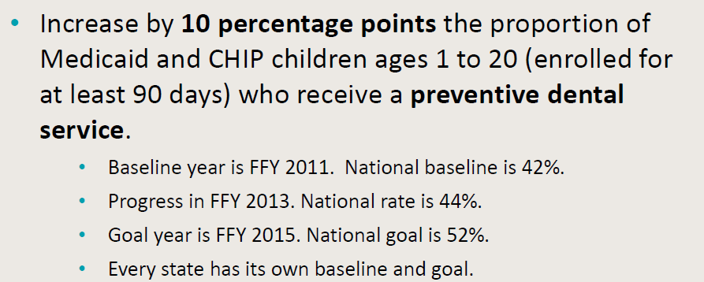
PIPs: Setting Goals
http://www.medicaid.gov/Medicaid-CHIP-Program-Information/By-Topics/Benefits/Downloads/OHIBaselineGoals.pdf

Slide 10
AHCA Dental PIP Analysis
Findings:
15 Preventive Dental PIPs evaluated
2 Plans listed barriers only
1 Plan did not list barriers or interventions
12 PIPs included barriers and interventions for evaluation

Slide 11
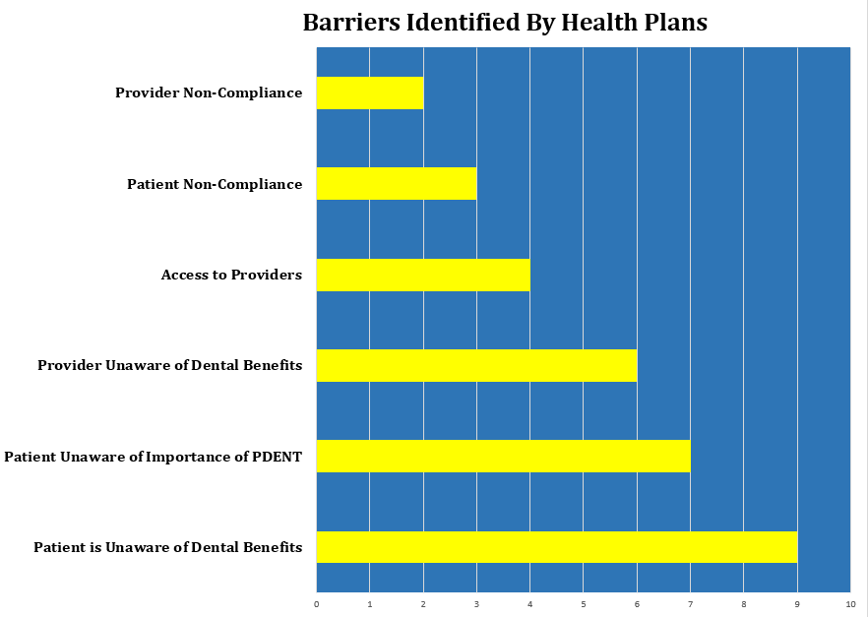
AHCA Dental PIP Analysis

Slide 12
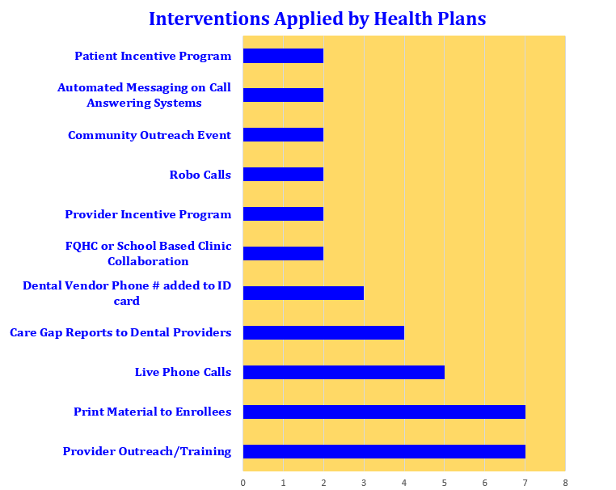
AHCA Dental PIP Analysis

Slide 13
Challenges

Slide 14
Barriers: Too Much, Not Enough…Just Right!
Challenges
Some plans listed too many barriers (over 100)
Some plans did not list any barriers
Some interventions did not match barriers
Choose barriers that are of high priority, that can have actionable interventions, sure to ‘move the needle’

Slide 15
Challenges
Interventions
Monitor interventions frequently for success
If you find an intervention to be unsuccessful, make a change
Research Innovations
Brainstorm with your team
Think outside of the box

Slide 16
Challenges-Most Common Points of Clarification
Research Techniques/Tools - Don’t be afraid to ask for help!
Accurate Calculations
Barrier prioritization
Evaluation, data collection method, threats to validity
HSAG will provide Technical Assistance

Slide 17
Successes: Interventions

Slide 18
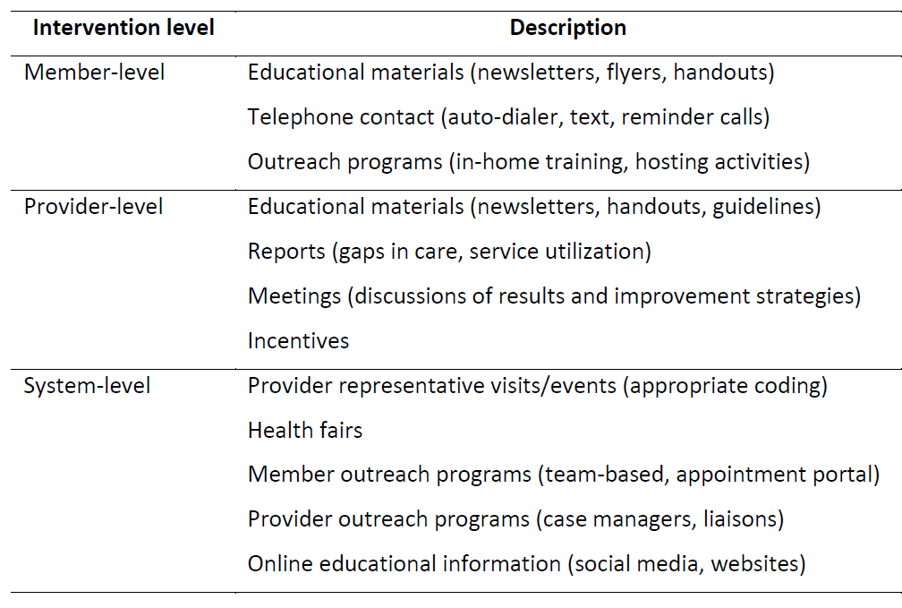
Common Interventions

Slide 19
Successes: Interventions
Use of social media to promote healthy oral hygiene (member-and system-level)
Text reminders (member-level)
Recognition and reward programs for providers who perform a high volume of preventive services (provider-level)
Outreach calls to members to identify barriers to care. (member-level) (AHCA will soon begin consumer engagement research)

Slide 20
MMA Plan Dental PIPs Unique Interventions
Quality Committees that meet weekly on specific subject matter (dental)
Focus Groups with PCPs about Dental Benefits
Member Advisory Committee
Partnerships & Collaborations (Schools, Mobile Dental Units, Head Start, Companies-Colgate)
Dental benefit Info added to Member ID

Slide 21
Successes: School-Based Sealant Program
Dental screening
Sealants if applicable
Fluoride treatment
Goodie bag and a referral to a dental home
Other dental services such as x-rays ,fillings, root canals, etc. at a referred dental home

Slide 22
Successes: School-Based Sealant Program
Check out the Online Calendar
http://hillsborough.floridahealth.gov/programs-and-services/clinical-nutrition-services/dental-services/school-sealant-program.html

Slide 23
Successes: Interventions
Visit This Link to Request a Van Visit or View the Tour Schedule!
http://www.colgate.com/app/BrightSmilesBrightFutures/US/EN/Mobile-Dental-Van/Van-Schedule.cvsp

Slide 24
Successes: Interventions
The Arizona School of Dentistry & Oral Health launched the initiative the "Text2floss" program.
Provides accurate oral health message tips about caring for your mouth.
Over 85% of Americans own a cell phone and 72% of cell users send or receive text messages.

Slide 25
Other State Successes:

Slide 26
State Interventions: Michigan
Healthy Kids Dental Press Release
Data on demographics, utilization, prevention visits in new counties
Met with local advocacy groups
Education of local advocates, health departments, special interest groups about HKD program
Designed a logo for HKD (branding)

Slide 27
State Interventions: Washington

Slide 28
State Interventions: Washington
Cavity Free Kids is oral health education for young children and their families.
It is designed for use in Head Start and Early Head Start, child care, preschool, home visiting, and other programs and for families to use at home.

Slide 29
State Interventions: North Carolina
Trains medical providers to deliver preventive oral health services to young children insured by NC Medicaid

Slide 30
State Interventions: Colorado
Cavity Free at Three is designed to help the healthcare provider have all of the resources and support that you need to join our statewide efforts to improve the oral health outcomes for Colorado’s kids.
On-site Cavity Free at Three training for dentists and staff
Downloadable parent education materials
Business planning for incorporating young children and/or Medicaid into your practice
Educational resources about early childhood caries for medical and dental providers
Technical assistance for becoming a Medicaid provider

Slide 31
Resources
Medicaid Oral Health Performance Improvement Projects: A How-To-Manual for Health Plans:
https://www.medicaid.gov/Medicaid-CHIP-Program-Information/By-Topics/Benefits/Dental-Care.html

Slide 32
Resources
Strategies to Address
Provider Participation Barriers
Program Administration and Delivery System Issues
Enrollee and Community Factors
https://www.medicaid.gov/medicaid-chip-program-information/by-topics/benefits/downloads/oral-health-quality-improvement-toolkit-for-states.pdf

Slide 33
Resources
http://www.floridadental.org/docs/default-source/foundation/pdc-resource-guide/pdc-guide-update---official.pdf?sfvrsn=2

Slide 34
Resources
Details of the Medicaid Dental Benefit for Children & Adolescents
Strategies for Promoting Oral Health for Children
https://www.medicaid.gov/medicaid-chip-program-information/by-topics/benefits/downloads/keep-kids-smiling.pdf

Slide 35
Take-Aways!
Refresher: Performance Improvement Projects- Look for More frequent PIP check ins
Findings from AHCA
Dental PIP Reviews: There are common barriers and interventions among health plans
Challenges: HSAG can provide technical assistance
Successes: Thinking outside of the box
A look at other states: Take a look at interventions in other states for ideas
Resources: Medicaid Oral Health Performance Improvement Projects: A How-To-Manual for Health Plans:

Slide 36
Questions!

