Slide 1
Florida Department of Health
County Health Department
School-Based Sealant Programs:
Frequently Asked Questions
Christina Vracar, DA, MPH
Public Health Dental Program Administrator
May 25, 2016
Notes:
Good Morning. My name is Christina Vracar, the Public Health Dental Program Administrator at Central Office in the Division of Community Health Promotion, Bureau of Family Health Services. The PHDP leads the Department of Health’s efforts to improve and maintain the oral health of all persons in Florida through four primary functions:
Providing a statewide direction for policy related to oral health issues
Promoting and administering oral health education and preventive dental programs
Collection and analyzation of data on oral health
Support the provision of direct dental care services through the County Health Departments and other public and private organizations.
Today I will be discussing some frequently asked questions regarding Florida Department of Health County Health Department School-Based Sealant Programs.

Slide 2
Florida School-Based Sealant Program Development
Sections 466.003 and 466.024, Florida Statutes
  Health Access Settings
  Hygiene services without the physical presence, prior examination, or authorization of a dentist
    Dental Sealants
Notes:
School-Based Sealant Programs function in accordance with Florida Statutes 466.003 and 466.024. County Health Departments are defined in 466.003 as a Health Access Setting in which a licensed dental hygienist (466.024) can provide limited preventive services without the physical presence, prior examination, or authorization of a dentist. Dental sealants are one of these services. As you can see in the images here, a non-toxic, thin plastic coating is applied to the chewing surface of a molar tooth to prevent up to 86% of tooth decay.

Slide 3
Florida Department of Health School-Based Sealant Program Development
Local decision to:
  Add a School-Based Sealant Program (S-BSP) to an existing County Health Department (CHD) Dental Program
or
  Initiate dental services at a CHD by implementation of a new S-BSP
Notes:
It is a local decision for Florida Department of Health CHDs to implement S-BSPs. S-BSPs can be built off of existing CHD dental programs or dental services can be initiated in a CHD through a new S-BSP.

Slide 4
CHD Sealant Return on Investment
Sealants can yield up to an 88% Return on Investment
  Every $1 invested in dental sealants at CHDs saves $1.88 in fillings
Notes:
Sealants decrease dental caries and can yield up to an 88% Return on Investment. This means that every $1 invested in dental sealants at CHDs saves approximately $1.88 in fillings. The approximate cost savings over three years for 39,095 children receiving at least one dental sealant at a CHD is $2,526,660.73.

Slide 5
Program Development
Cost-effective workforce and equipment models
Notes:
Utilizing a cost-effective workforce model (dental hygienists) and equipment models (portable equipment) start-up and recurring costs are minimized. The photos here show dental hygienists providing preventive dental services to children utilizing portable equipment.

Slide 6
County Health Department
School-Based Sealant Program
Service Delivery Process Map
Notes:
This is an example of how CHD S-BSP service delivery takes place. This process map starts with school district interest and approval for CHD access. If authorization is given by the school board, the CHD will schedule a date with the school, receive parent/guardian consent, provide services to children returning a positive consent form, bill for reimbursement of services provided to sustain the program, and refer children to a dental home for comprehensive oral healthcare.

Slide 7
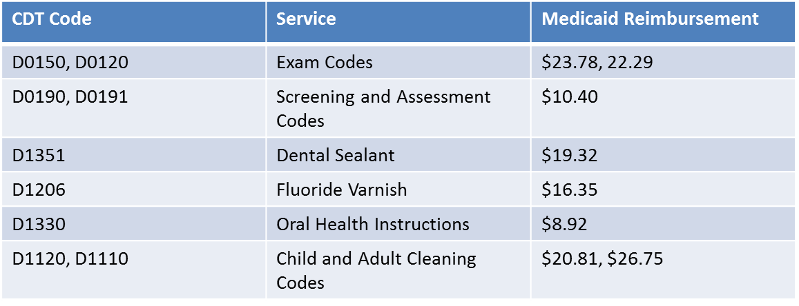
Services Billed
Depending on the model, the following services are commonly provided and billed for by CHD S-BSPs:
Notes:
Local CHD S-BSP vary greatly in regards to workforce and service delivery models. This listing of Common Dental Terminology (CDT) codes are common amongst CHD S-BSPs. They include exams, screenings, assessments, dental sealants, fluoride varnish, oral healthcare instructions, and prophylaxis.

Slide 8
Data Collection
The Florida Department of Health’s Health Management System (HMS) is used to record dental services and bill for services provided.
Notes:
Service data collection takes place in the Florida Department of Health through the Health Management System. All CHDs enter all service level data and bill for reimbursement of dental services for select enrollees of a dental subcontractor with a DOH state or local valid contract. If there is not a valid state or local contract, the service is not billed but simply recorded in HMS.

Slide 9
Managed Care
Frequently Asked Questions
Does the S-BSP administrator have access to FLMMIS?
  Yes.
How do health plans know if a child enrolled in their plan has received sealants in a school based sealant program?
  Place of Service Designation: 03.
Notes:
1. Does the S-BSP administrator have access to FLMMIS?
Yes, the S-BSP clerical, billing, service, and administrative staff at CHDs should have access to FLMMIS.
2. How do health plans know if a child enrolled in their plan has received sealants or other services in a school based sealant program?
The claim form has a Place of Service Designation: 03.

Slide 10
Managed Care
Frequently Asked Questions
In order for health plans and CHDs to collaborate, is there a requirement to have a contract between the two entities?
  Yes.
How can health plans help their enrolled children/families be more aware of S-BSPs in their area?
  flhealth.gov/dental
  https://youtu.be/Ukmpx7rd8pE
Notes:
3. In order for health plans and CHDs to collaborate, is there a requirement to have a contract between the two entities (to share data, etc.)?
Yes, there will be a contract between the dental subcontractor and the CHD for reimbursement of dental services provided to enrolled members.
4. How can health plans help their children/families be more aware of S-BSPs in their area?
Relay the availability of services for CHDs with a S-BSP by providing the following links for services in their respected areas.

Slide 11
Managed Care
Frequently Asked Questions
How can the health plans assist in increased returned consent forms?
  Ensure the members are aware of DOH S-BSPs in their county.
Is there data available for DOH S-BSPs?
  Yes.
  46 CHDs with a S-BSP accessing over 600 Florida schools.
  Over 15,000 children received more than 56,000 sealants during SFY 2014-2015.
Notes:
5. How can the health plans assist in increased returned consent forms?
Ensure the members are aware of DOH S-BSPs in their county. Opportunity exists to work with the county and receive a school schedule. This is not set up a year in advance for statewide dissemination. Local scheduling timelines and approval vary by CHD S-BSP.
6. Is there data available for DOH S-BSPs?
Yes.
Currently, there are 46 CHDs with a S-BSP and they are accessing over 600 Florida schools.
During State Fiscal Year 2014-2015, over 15,000 children received more than 56,000 sealants through a DOH S-BSP.

Slide 12
County Health Departments with a School-Based Sealant Program as of April 2016
Glades
Hamilton
Hendry
Hernando
Highlands
Holmes
Indian River
Jackson
Jefferson
Lake
Lee
Leon
Liberty
Madison
Martin
Nassau
Orange
Palm Beach
Pasco
Pinellas
Polk
Putnam
St. Johns
St. Lucie
Seminole
Sumter
Union
Volusia
Wakulla
Walton
Washington
Baker
Bay
Bradford
Brevard
Broward
Calhoun
Charlotte
Citrus
Clay
Columbia
Miami-Dade
DeSoto
Duval
Flagler
Franklin
Notes:
This slide lists the 46 current Florida Department of Health CHDs with a S-BSP. There are 21 CHDs without a S-BSP. The goal is for all 67 CHDs to have a S-BSP.

Slide 13
ESCAMBIA
SANTA ROSA
OKALOOSA
HOLMES
JACKSON
WALTON
WASHINGTON
GADSDEN
JEFFERSON
HAMILTON
NASSAU
BAY
CALHOUN
LEON
MADISON
DUVAL
LIBERTY
WAKULLA
TAYLOR
SUWANNEE
COLUMBIA
BAKER
GULF
FRANKLIN
LAFAYETTE
UNION
CLAY
ST JOHNS
BRADFORD
DIXIE
GILCHRIST
ALACHUA
PUTNAM
FLAGLER
LEVY
MARION
Florida Department of Health
County Health Department
School-Based Sealant Programs
VOLUSIA
CITRUS
LAKE
SUMTER
SEMINOLE
HERNANDO
ORANGE
BREVARD
PASCO
HILLSBOROUGH
POLK
OSCEOLA
PINELLAS
INDIAN RIVER
MANATEE
HARDEE
OKEECHOBEE
ST LUCIE
DESOTO
HIGHLANDS
SARASOTA
MARTIN
CHARLOTTE
GLADES
LEE
HENDRY
PALM BEACH
COLLIER
BROWARD
MONROE
DADE
Notes:
Here is a map showing the current 46 CHDs with a S-BSP.

Slide 14
Managed Care
Frequently Asked Questions
Can the health plans capture the services in this state fiscal year that have already been rendered?
  Yes.
  Dental Subcontractor.
  https://home.flmmis.com/.
Notes:
7. Can the health plan capture the services in this state fiscal year that have already been rendered?
Yes, the health plan can retrieve this information from the dental subcontractor or FLMMIS.

Slide 15
Managed Care
Frequently Asked Questions
How can health plans receive more information on the billing process and claims information for children who are receiving services?
  Agency for Health Care Administration (AHCA)
  Health plan’s dental subcontractor
  Additional statewide or local contracts at sustainable rates
Notes:
8. How can health plans receive more information on the billing process and how to capture claims for children who are receiving services?
Plans can work with AHCA to receive more information on the billing process and locate claim history
All services provided to enrolled members of a dental subcontractor plan which has an active and valid contract with the CHDs will receive a claim form with claim information.
Additional statewide or local contracts at sustainable rates for CHDs will increase children served and capture claims for children receiving services.

Slide 16
Contact Information
Christina Vracar, DA, MPH
Public Health Dental Program Administrator
(850) 245-4476
Christina.Vracar@flhealth.gov
Notes:
Thank you for your time. Please see my contact information provided here.

