Slide 1
Sustaining Recovery for Patients on MOUD–Part 1
Ensuring Medication for Opioid Use Disorder (MOUD) Treatment through the Care Continuum Webinar Series
Friday, April 12, 2024
In partnership with all Quality Innovation Network-Quality Improvement Organizations

Slide 2













QIN-QIO Partnership to Address the Opioid Epidemic
This series is a collaboration of all Quality Innovation Networks–Quality Improvement Organizations (QIN-QIOs). National experts across the healthcare continuum provide robust educational content to address the opioid epidemic.

Slide 3
Learning Objectives
Describe how to support people in recovery beyond the walls of the hospital, nursing homes, and opioid treatment programs (OTPs).
Review the steps to ensure continuity and/or provide access to treatment for patients with OUD.
Learn more about the specific strategies that can be implemented in rural communities.
Discuss how to coordinate and sustain this support with your community partners.

Slide 4

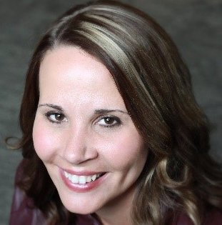
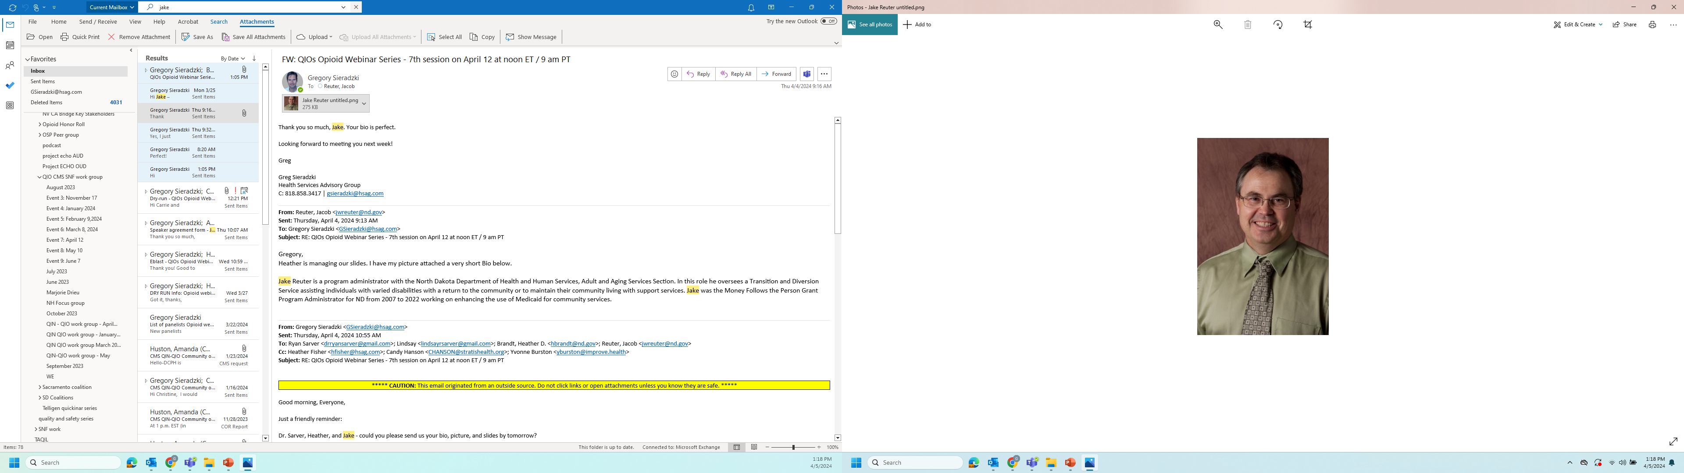
Guest Speakers
Ryan Sarver, MD, FAAFP
Fellow of the American Academy of Family Physicians
Adjunct Assistant Professor of Clinical Family Medicine for Indiana University School of Medicine
Pain Physician for the Veterans Health Administration
Heather Brandt
Manager, North Dakota Behavioral Health Community Supports
Jake Reuter
North Dakota Health and Human Services (HHS), Administrator
Notes:
Bios
Jake Reuter is a program administrator with the North Dakota Department of Health and Human Services, Adult and Aging Services Section. In this role he oversees a Transition and Diversion Service assisting individuals with varied disabilities with a return to the community or to maintain their community living with support services. Jake was the Money Follows the Person Grant Program Administrator for ND from 2007 to 2022 working on enhancing the use of Medicaid for community services.

Slide 5
MOUD through Primary Care
Addiction is a treatable chronic relapsing disease of the brain
Life saving treatments of medication assisted treatment of OUD:
  Naltrexone: once monthly injection
  Methadone: DATA 2000 law, only through Opioid treatment Program (OTP)
  Buprenorphine: Sublingual tablet, Film, Depo injection
All providers with an active Drug Enforcement Agency (DEA) license can now prescribe Suboxone
All primary care providers should be prescribing Medication Assisted Treatment (MAT) to their patients with OUD

Slide 6

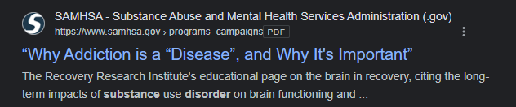
MOUD through Primary Care
Addiction is a treatable chronic relapsing disease of the brain
https://www.samhsa.gov/sites/default/files/programs_campaigns/02._webcast_2_resources.pdf

Slide 7
MOUD Through Primary Care
Addiction is a treatable chronic relapsing disease of the brain
Life saving MAT:
  Naltrexone: once monthly injection
  Methadone: DATA 2000 law, only through OTP
  Buprenorphine: Sublingual tablet or Film, Depo injection
All providers with an active DEA license can now prescribe Suboxone
All primary care providers should be prescribing MAT to their patients with OUD

Slide 8
Points of Entry
Emergency department (ED) warm handoff
Screening for substance use disorders
Patients who fail pain management
Referrals from other primary care providers

Slide 9
Points of Entry
Pt presents to ED for OD and is triaged by PRC and connects patient to CHW
Rehab
Community Recovery Resources
Outpatient MOUD Induction
IOP with OTP
Referral to Counseling
CHW connects patient to Community Resources
Pt = Patient
OD = Opioid Overdose
PRC = Peer Recovery Coach
CHW = Community Health Worker
IOP = Intensive Outpatient Program

Slide 10
Clinic Flow
Urine Drug Screening (UDS)
MAT Contract vs. Informed Consent
Set expectations

Slide 11
Pitfalls
People with lived experience
Administrative hurdles
Social determinants of health
Trauma informed care
Stigma

Slide 12
Patient Support
Peer recovery professionals
Behavioral health
Federally Qualified Health Center (FQHC)
OTP
Programs offering IOPs
Rehab and detox

Slide 13

North Dakota Health & Human Services
13

Slide 14
History and Gaps
2016: Department of Corrections and Rehabilitation
The number of people in North Dakota’s prisons and jails on probation and on parole was increasing; it is projected to grow by 36% by FY 2022 at a cost of $115 million. The use of prisons for those violating supervision conditions and committing lower-level nonviolent offenses, paired with a lack of sufficient community behavioral health services for individuals with mental illness and substance use disorders (SUDs), hinders the state's ability to reduce recidivism or reduce growth.
Reinvest the dollars that were designated for prison and invest in community-based behavioral health (BH) support services.
2018: Behavioral Health System Study
Identified that the behavioral health system was primarily crisis oriented and paid inadequate attention to rehabilitative and community-based services.
14

Slide 15

North Dakota Behavioral Health System Study
April 2018
“A well-functioning behavioral health system attends not only to the intensive needs of children, youth, and adults with serious mental health conditions and SUDs but also to the outpatient and community-based service and support needs of individuals and, critically, to the social and emotional well-being of the majority of the population who have not been diagnosed with a BH condition—especially children, youth, and young adults.”
15

Slide 16
Solutions
Changing the systems response to people that are struggling with addiction and mental health, connection to recovery support services
  Invest in community-based solutions, regionally focused across North Dakota
  Engage with faith-based, culturally-specific groups, private providers that are interested in providing services
    Provide training and ongoing technical assistance and support
    Funding for services
    Provider guidance
16
Notes:
NDCC gave authorization to the ND Department of Health and Human Services, Behavioral Health Division and DOCR funding and FTE’s to create a community behavioral health program. I’m going to highlight some state funded and Medicaid funded programs/services that have expanded the availability of support services for individuals.

Slide 17
Decision Points
Who?
How?
What?
ND initially targeted people on parole and probation
Utilized a corrections assessment tool to identify those with most risks
Care Coordination and Peer Support
17

Slide 18
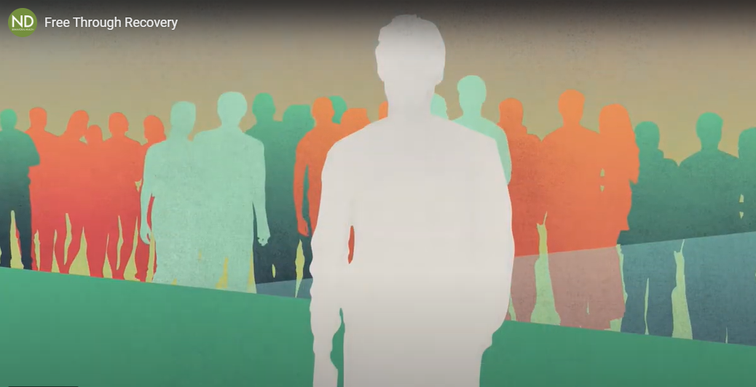
Free Through Recovery
18

Slide 19
Free Through Recovery
Goal 1: Improve Engagement in Quality Services
Participants engage with a care coordinator who identifies their needs and helps the participant find creative, effective, and prosocial ways to meet these needs.​
Participants engage with a Peer Support Specialist with lived experience with serious behavioral health conditions.
19

Slide 20
Free Through Recovery
Goal 2: Provide Access to Individualized Services That Are Responsive to Each Person’s Specific Needs
Providers establish formal relationships with behavioral healthcare providers, housing resources, and employment supports.​
Communities identify and report service gaps or barriers to meeting the needs of participants that are specific to their location.​
20

Slide 21
Free Through Recovery
Goal 3: Expand the Behavioral Health Workforce​
Partner with a wide range of providers, consisting of large, statewide organizations to one-person shops, all serving the community.​
Providers represent every area of service, culture, gender, faith, etc., and work together.
21

Slide 22
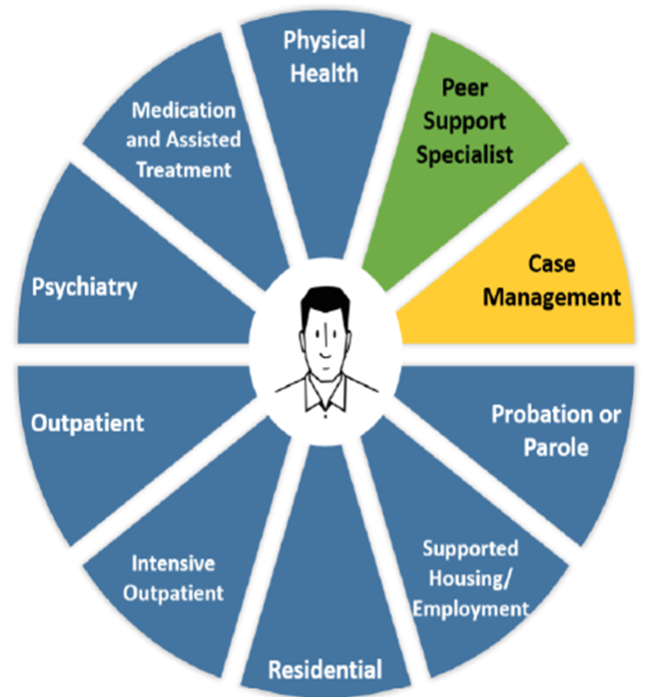
Free Through Recovery
Community/regionally based providers enter into Provider Agreement/Contract with HHS Behavioral Health Division
Per person, outcome-based rates, incentive engagement and wellness
Provider delivers care coordination and peer support services
  Engagement
  Care Plan Development
  Referrals/Navigation/Connect
22

Slide 23
Implementation Tasks
Rate establishment
Recruit and hire administrators
RFP/contract content/provider agreements for care coordination and peer support services
Public meetings in implementation sites
Contract for peer support development/training
Training care coordination and peer support
Communication loop development
Data collection strategy
Quality assurance (QA), monitoring, and reporting
23

Slide 24
Successes/Challenges
Successes
Development & expansion of BH workforce in our communities
(Ex: Providers at NDSP Resource Fair)
Currently 378 active/trained care coordinators serving.
Challenges
Rising capacity needs
Quality of care
Internal QA & data analysis
24

Slide 25

Community Connect
Notes:
In 2019 ND legislature passed to create a new program that was expansion of the FTR model beyond the DOCR specific population

Slide 26


Expansion Beyond DOCR Specific Population
Community/regionally based providers enter into Provider Agreement/Contract with HHS Behavioral Health Division
Per person, outcome-based rates, incentive engagement and wellness
Provider delivers care coordination and peer support services
  Engagement
  Care Plan Development
  Referrals/Navigation/Connect
26
DOCR: Department of Corrections and Rehabilitation

Slide 27
Successes/Challenges
Successes
Development and expansion of BH workforce in our communities
Providers serving specific populations: domestic violence survivors, NFI population, LGBTQA, etc.
Serving individuals outside of the state-level criminal justice system
Care coordinator code of ethics
Challenges
Rising capacity needs
Decreasing program census
Quality of care
Internal QA
27
NFI = New American, Foreign Born, and Immigrant
LGBTQA = Lesbian, Gay, Bisexual, Transgender, Queer, Questioning, and Other Allies

Slide 28

1915(i)
Home and Community-Based Behavioral Health Support
Notes:
As I discussed earlier in 2018 there was a study facilitated that highlighted the needs for more community-based support service for people with behavioral health, a 1915i state plan amendment was created to respond to those needs

Slide 29

What is the 1915(i)
Amendment to the ND State Medicaid Plan
Developed to fill gaps in BH service delivery system throughout ND, supporting people in their community of choice
Allows for the provision of home and community-based services not previously billable to Medicaid

Slide 30
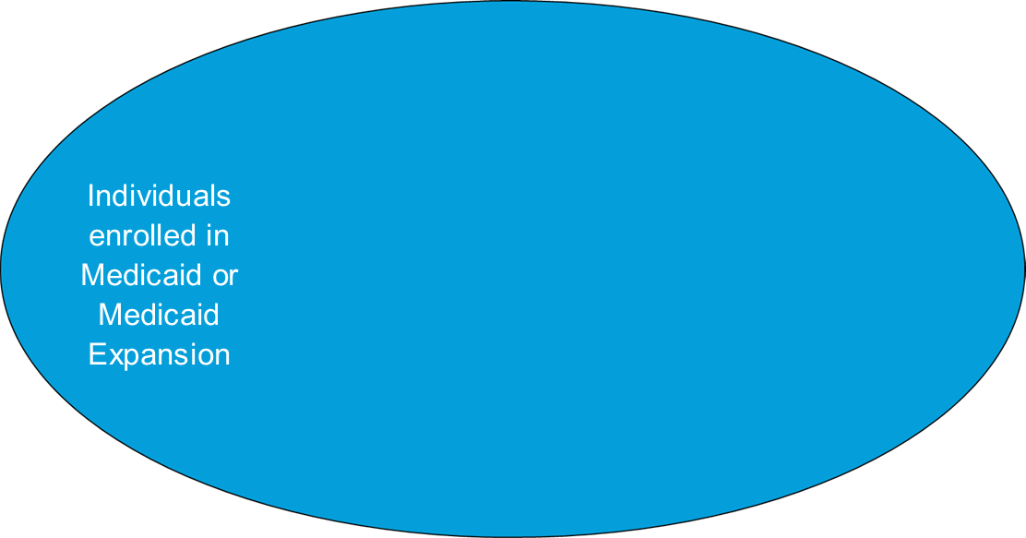
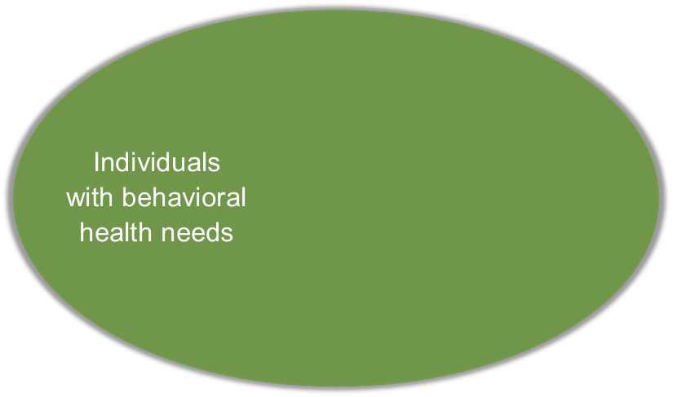
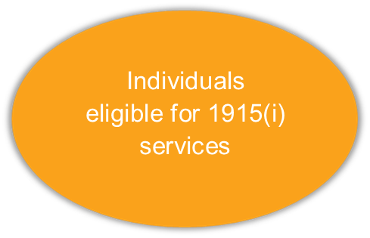
Target Population
30

Slide 31

1915(i) Services
Care Coordination (All ages)
Peer Support (18+)
Non-Medical Transportation (All ages)
Housing Support (17.5+)
Benefits Planning (All ages)
Pre-Vocational Training (17.5+ or has GED/Diploma)
Supported Employment (14+)
Supported Education (5+)
Respite (0 through 20)
Training & Support for Unpaid Caregivers (All ages)
Family Peer Support (0 through 17)
Community Transition Service* (All ages)

Slide 32
Individual Enrollment
Completed eligibility application submitted
Eligibility worker at zone determines the individual is eligible for 1915(i) services
Individual chooses care coordinator, with or without assistance from navigator
Individual and care coordinator develop person-centered plan of care
Care coordinator requests additional provider(s) on behalf of individual
Additional provider requests pre-authorization, services are provided
32

Slide 33
Benefits
Building community/state capacity to respond to BH needs
  Business development
  Rural/frontier
Employment opportunities and pathways to BH careers
Providers that are regionally/locally based, meeting the unique needs of each community
  Services may look different depending on region/community
Identify gaps in services and supports
Ongoing training and technical assistance for providers
Over 45 new BH providers in North Dakota since 2019
Peer-run organizations
Faith-based
Culturally specific
Statewide and smaller/regionally based providers
33
Notes:
We have been working together with behavioral health providers and providing agencies working with adults with physical disabilities and aging to work to meet their caring support needs as well as their behavioral health needs, Jake is going to highlight some programs that assist financially and practically in helping people find and securing housing in the community.

Slide 34
Other Support Programs
SUD Voucher
Recovery Housing Assistance Program
Mental Health Program Directory
Mental Health Bed Registry
ND Brain Injury Services
34
Notes:
We have been working together with behavioral health providers and providing agencies working with adults with physical disabilities and aging to work to meet their caring support needs as well as their behavioral health needs, Jake is going to highlight some programs that assist financially and practically in helping people find and securing housing in the community.

Slide 35
Adult and Aging
American Rescue Plan Act Section 9817
Transition and Diversion Services Pilot Project
Diversion—Assistance to remain in community
Transition Coordination
Housing Facilitation
$1,500 to $2,000 to assist with diversion from and institutional setting
Transition—move to new home
Transition Coordination
Housing Facilitation
$1,500 to $2,000 to assist with diversion to a new living situation
35

Slide 36
Identified Needs
Adults with physical disabilities or older adults are presenting with significant BH needs.
BH providers are not trained to provide ADLs and QSP providers are not trained to respond to BH needs.
Develop training for the care providers to support the BH needs of the individuals now being referred for support services.
  BH Endorsement/Certificate
ADL = activities of daily living
QSP = qualified services provider
36

Slide 37

Peer Support and Adult and Aging Services
Adult and Aging Services partnering with the BH Division to develop a peer support network for older adults and persons with a physical disability.
Purpose:
Provide support for transition and diversion related concerns and BH-related issues.
37

Slide 38
Transition Services
Money Follows the Person Grant
https://www.medicaid.gov/medicaid/long-term-services-supports/money-follows-person/index.html
Assists Medicaid eligible individuals transition from the following institutional settings
Nursing facilities
Hospitals
Intermediate care facilities for individuals with an intellectual disability
Community Transition Services
Waivers and 1915(i) State Plan Services
North Dakota offers this service in the following programs:
Aging and Disabilities Waiver
Developmental Disabilities Waiver
1915(i) State Plan Amendment to support individuals with behavioral health conditions
38

Slide 39
Housing Navigation Services
Assist individuals in their housing search.
Fill out applications for housing subsidies and for potential rental units.
Assist in locating needed documents for applications.
Attend viewing of rental units including the walk-thru before signing of the lease.
Assure the client understands the terms of the lease.
Connect client to agencies that will be providing services.
Assure modifications and accommodations are in place when moving in and appropriate as needs change.
Participate in the development of the transition plans.
This service is offered in the following programs:
Money Follows the Person Grant
ND Rent Health Housing Stabilization
Transition and Diversion Services Pilot Project (10% ARPA Funds)
1915(i) State Plan Amendment
North Dakota Homeless Grant
Emergency Solutions Grant
State Funded BH Services (Community Connect and Free Through Recovery)
39

Slide 40
State Funded Services
Service Payments for the Elderly and Disabled (SPED)
Expanded Service Payments for the Elderly and Disabled (Expanded-SPED)
40

Slide 41

Contact Information
Heather Brandt, Manager, Behavioral Health Community Supports
  hbrandt@nd.gov
Jake Reuter, Health and Human Services, Administrator
  jwreuter@nd.gov
www.behavioralhealth.nd.gov

Slide 42

Meet One of Our Upcoming Speakers
Lindsay Sarver
Community Health Improvement Strategist
Notes:
Lindsay Sarver is the Community Health Improvement Strategist for Healthy Jackson County Coalition, a cohort of over three hundred community stakeholders seeking to improve the health of Jackson County, IN and surrounding areas. Ms. Sarver has two decades experience in social services, working with adults and adolescents experiencing serious mental illness, substance use, and individual and collective trauma. Lindsay's education is in Justice Studies, with an emphasis on human rights from Arizona State University; she has pursued additional certifications in chemical addictions counseling, obtained her Masters in Paralegal Studies from the George Washington University, and had the privilege of studying the impact of collective and individual trauma in South Africa. Lindsay works through the hospital and Healthy Jackson County to create collaboration and address logistical and ideological barriers to success in clinical and community settings seeking to improve mental health and substance use interventions.

Slide 43

Questions
  Ryan Sarver, MD, FAAFP
  DrRyanSarver@gmail.com
  Heather Brandt
  hbrandt@nd.gov
  Jake Reuter
  jwreuter@nd.gov

Slide 44
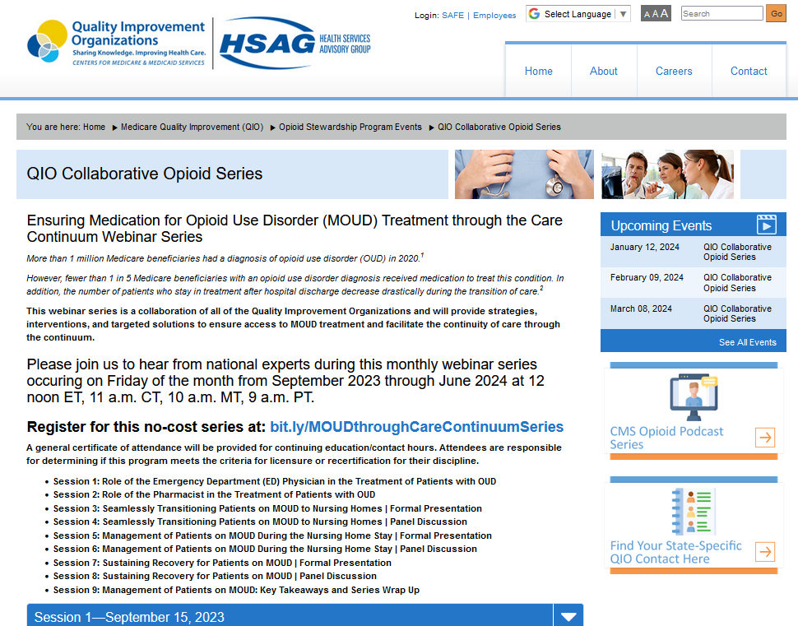
Your State-Specific QIO Point of Contact
https://www.hsag.com/qiocollabopioidseries

Slide 45
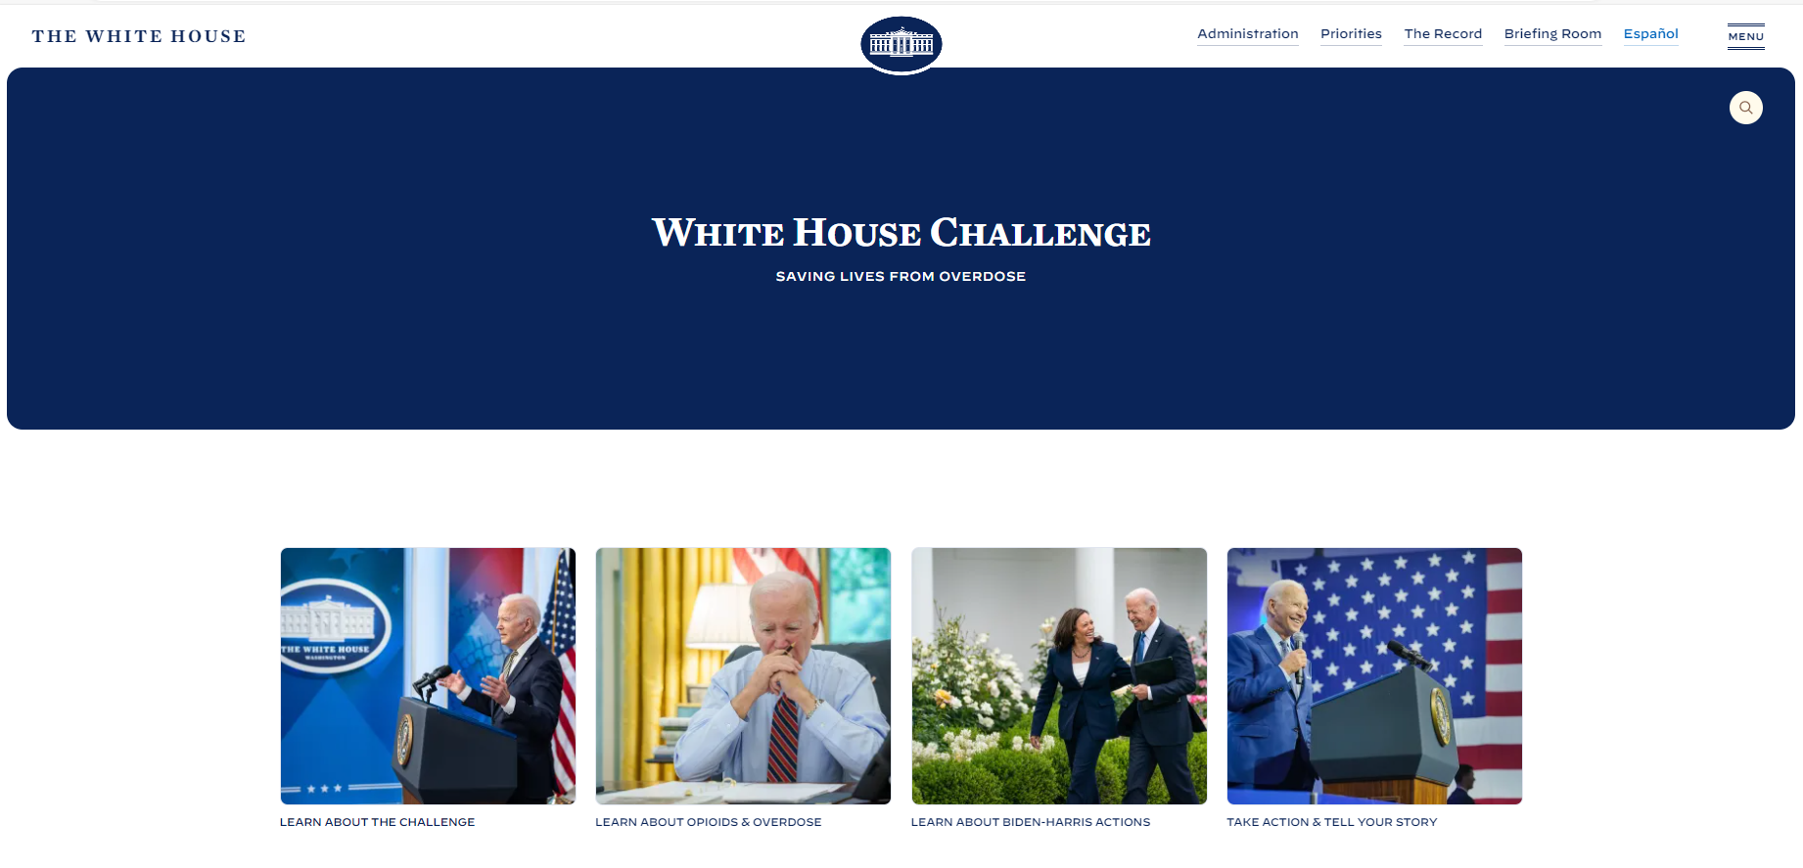
White House Opioid Challenge
White House Challenge to Save Lives from Overdose | The White House
https//www.whitehouse.gov/savelivesfromoverdose

Slide 46


What’s Next
Join us for the next
session on May 10, 2024:
Sustaining Recovery
for Patients on MOUD – Part 2
bit.ly/MOUDthroughCareContinuumSeries
Recordings, slides, and resource links
are posted for on-demand access
72 hours after every session.
https://www.hsag.com/qiocollabopioidseries

Slide 47
Certificate of Attendance
Continuing Education Credits and Contact Hours for
Health Professionals
This series may meet continuing education requirements for your discipline. You may use this certificate as proof of attendance. It is your responsibility to determine if the series fulfills that requirement.
The link to request a certificate of attendance is below and will be included in the follow-up email sent directly to you by Webex.
New User Registration Link:
https://lmc.hshapps.com/register/default.aspx?ID=18e68e67-0272-4087-956c-69061ae88f96
Existing User Link:
https://lmc.hshapps.com/test/adduser.aspx?ID=18e68e67-0272-4087-956c-69061ae88f96

Slide 48
Thank You
Slides 1, 2, and 43–48. This material was prepared by Health Services Advisory Group, a Quality Innovation Network-Quality Improvement Organization under contract with the Centers for Medicare & Medicaid Services (CMS), an agency of the U.S. Department of Health and Human Services (HHS). Views expressed in this material do not necessarily reflect the official views or policy of CMS or HHS, and any reference to a specific product or entity herein does not constitute endorsement of that product or entity by CMS or HHS. Publication No. QN-12SOW-XC-04112024-01

