Slide 1
2018 Increase Rate of Patients Dialyzing at Home Using the 7-Step Process Quality Improvement Activity (QIA)
Donna DeBello, RN
Quality Improvement Director Health Services Advisory Group (HSAG): End Stage Renal Disease (ESRD) Network 7
January 31, 2018

Slide 2
Orientation Webinar Housekeeping
To verify facility attendance, please send an email after the call with the names of the facility and attendees to Donna DeBello at ddebello@nw7.esrd.net.
This webex is being recorded for attendance purposes.
This is a phone conference, so please mute your phone.
To mute/un-mute *6

Slide 3
Webinar Agenda
QIA Introduction, Criteria, Goals
Interventions and Timelines
QIA Data Reporting
Patient and Family Engagement
Learning and Action Network (LAN)
Best Practices for Success and Sustainment
Addressing Health Disparities
Questions

Slide 4
QIA Introduction
Home modalities are underutilized in the U.S., with only 8% of dialysis patients on a home modality compared to 92% being treated in-center.
The intent of this QIA is to:
Promote referral to home modalities.
Identify barriers to timely referral.
Determine the steps patients and providers can take to improve referral patterns.

Slide 5
QIA Facility Inclusion Criteria
For facility inclusion:
The Network identified 30% of facilities within the Network service area for participation based on their percentage of patients training on a home modality during the period of October 2016 to June 2017*.
For patient inclusion:
An eligible patient is any patient who is a non-transient patient and is not currently on a home modality.
For patient exclusion:
Patients will be excluded if they:
Are not interested in a home modality and it is documented in their patient record.
Are currently a home patient on “back-up” hemodialysis.
Have a medical exclusion documented in their patient record and reported to the Network.
*Source: Centers for Medicare & Medicaid Services (CMS)

Slide 6
Network Criteria for Success
For patient credit:
Patient initiates home training (Step 7)
A patient will be considered initiated when the “Dialysis Training Start Date” is recorded in the CROWNWeb treatment record.
For facility credit (referring facility):
The facility that treats the patient directly prior to the admission/treatment record with a Training Start Date, will be considered the “Referring Facility” and will receive credit.
For successful completion of QIA
Facilities must demonstrate a 10 percentage point increase in the number of eligible patients training on a home modality from the baseline by July 2018.

Slide 7
QIA Goals
Increase in the number of eligible patients training on a home modality within a targeted group of in-center dialysis facilities.
10 percentage points over baseline
Improve collaboration between in-center staff and home modality staff.
Improve knowledge of home modalities for in-center staff.
To provide needed support to patients transitioning to home training.
Improve the tracking and transitioning of eligible patients training on a home modality using the 7-Steps to Home Training tracker.

Slide 8
Interventions
Complete root cause analysis (RCA)
Use the 5 Why’s.
Activate the Plan-Do-Study-Act (PDSA) cycle.
Identify barriers in the 7-Step process to patients initiating home training
Report findings in the Initial Assessment Survey Monkey link provided by the Network.
Partner with home programs
Identify a lead home nurse and experienced home dialysis patients to collaborate for assistance with home modality education.

Slide 9
Interventions (cont.)
Educate staff
Collaborate with lead home nurse to provide an in-service or “homeroom” education session.
Educate Patients
Provide education to eligible patients.
Encourage a current home dialysis patient to act as mentor and support through the 7-Step process to home training.
Build Relationships
Collaborate with Medical Director and nephrologists to identify local surgeons for timely patient appointments and follow up.

Slide 10
Interventions (cont.)
Attend the ESRD National Coordinating Center (NCC) LAN per CMS guidelines
It is mandatory that each facility in the Home QIA attend the ESRD NCC LAN every other month.
Attendance will be tracked by the Network and reported to CMS monthly.
Implement patient and family engagement activities
Include patient subject matter experts (SMEs) in all patient-related activities for this QIA.
Identify and report best practices
Share and report monthly activities that have assisted in the timely navigation of in-center patients through the 7-step process to home training.

Slide 11
PDSA Cycle

Slide 12
QIA Planner (Timelines)

Slide 13
Monthly Reporting via Survey Monkey
For 2018, monthly reporting will be completed/submitted via Survey Monkey. Links to the specific month’s reports will be provided to you by the Network and will include links to:
The Initial assessment report with RCA and barriers to each of the 7-Steps to home training.
Due February 15
Monthly reporting from March–September.
Due on the 5th of the reporting month for the month prior.

Slide 14
7-Steps to Home Training
Patient Home Dialysis Interest
Implement the Home Modality Patient Interest Questionnaire with new and existing patients.
Modality Preference
Educate patients on home modalities and document patient preference.
Patient Suitability
Review the Method to Assess Treatment Choices for Home Dialysis (MATCH-D) with the Interdisciplinary Team (IDT) and nephrologist to assess patient suitability.

Slide 15
7-Steps to Home Training (cont.)
Schedule Appointment for Appropriate Access
Assist nephrologist in timely coordination of surgical consult.
Access Placement
Track appointment for timely follow-up with surgeon.
Accepted Into Home Program
Collaborate with lead home nurse for patient training schedule date.
Initiates Home Training
Coordinate transition of patient from in-center to home modality with lead home nurse and document in CROWNWeb.

Slide 16
7-Steps to Home Tracker

Slide 17
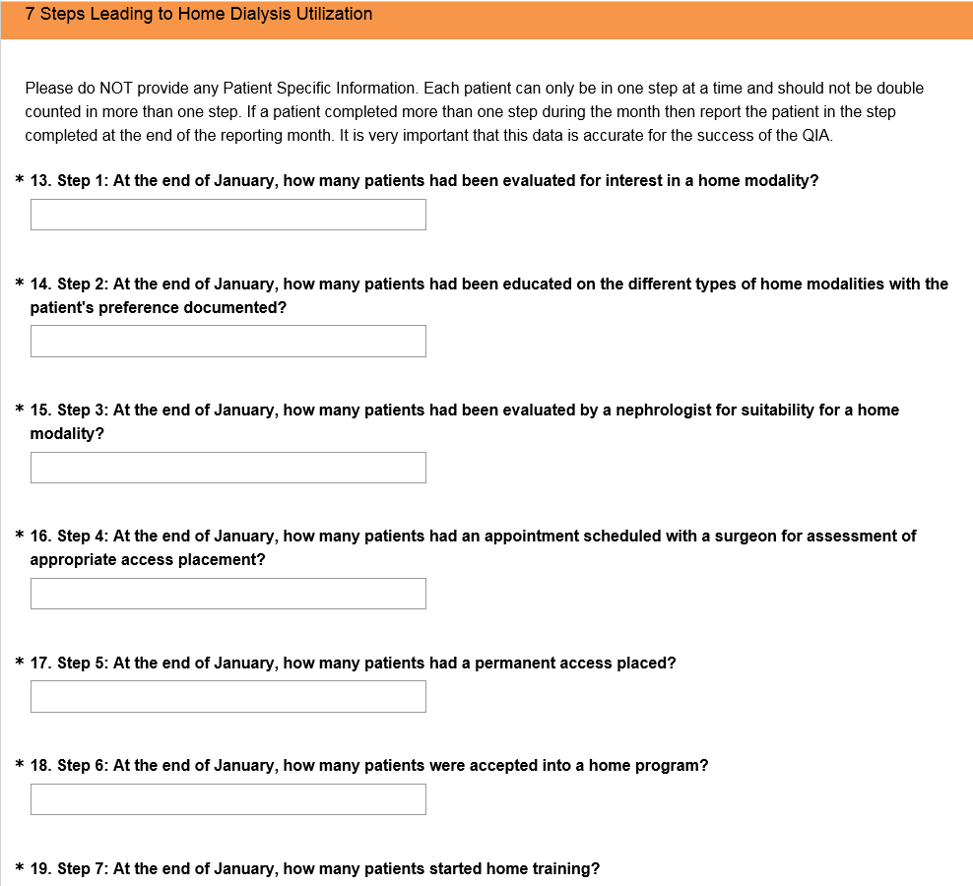
7-Step Questions on Survey Monkey

Slide 18
Patient and Family Engagement at the Facility Level
CMS requires that the Network:
Ensure the implementation of interventions at the dialysis facility level that foster patient and family involvement.
Assist facilities in adjusting to the heightened focus on patient and family centered care by providing technical assistance on:
Establishing a patient and family council support group and/or new patient adjustment group.
Incorporating patient, family, and caregiver participation into the Quality Assurance Performance Improvement (QAPI) Program and governing body of the facility.
Developing policy and procedures related to patient, family and caregiver participation in patient care.

Slide 19
NCC Home Dialysis LAN
Each facility must participate in the NCC Home Dialysis LAN calls.
LAN calls begin in February and will then be held ever other month.
LANs are:
A forum for patients, family members, caregivers, providers, and other stakeholders to share ideas around a shared goal.
Mechanisms by which large scale improvement toward the achievement of a person-centered outcome based goal is fostered, studied, adapted, rapidly spread, and sustained.
Regardless of the change methodology, tools, or time-bounded initiative used.

Slide 20
Best Practices: Success and Sustainment
Best practices for successful completion of this QIA and sustainment of progress made include:
Identifying a home lead nurse, home patient mentors, and SME’s.
Collaborating with modality educators to offer comprehensive home modality education.
Tracking patients through each of the 7-Steps toward home training using either the 7-Steps to Home Dialysis tracker or an internal tracker.
Providing continuous timely support of patients through the 7-Steps to home training.
Hosting a “Lobby Day” to coordinate a meeting between interested patients and family members and existing patients dialyzing at home.
Reporting monthly to the Network via the Survey Monkey links provided.
Building relationships and collaborating with the medical director and nephrologists to identify local surgeons for timely appointments and patient follow-up.

Slide 21
QAPI
During monthly QAPI meetings:
Introduce your inclusion in this QIA meeting to engage the support of your medical director and IDT.
Discuss the patient interest questionnaires and assess patients for suitability using the Match-D.
Discuss individual patients’ progress through the 7-steps, barriers encountered at each step, and resolutions designed by your team that may be shared as best practices.

Slide 22
Health Disparities
Health disparities are differences in health outcomes closely linked with social, economic, and environmental disadvantage – are often driven by the social conditions in which individuals live, learn, work, and play. Characteristics including race, ethnicity, disability, sexual orientation or gender identity, socio-economic status, geographic location, and other factors historically linked to exclusion or discrimination are known to influence the health of individuals, families and communities.
An additional resource from the Centers for Medicare and Medicaid Services (CMS) will be sent out to all participants with more information.
To learn more contact: HealthEquityTA@cms.hhs.gov
Source: Centers for Medicare & Medicaid Services

Slide 23
Resources
Monthly planner (timelines)
Network will send out after webinar
Link to the MATCH-D patient suitability assessment
http://homedialysis.org/match-d
Link to a disparity resource from CMS
Guide to Preventing Readmissions Among Racially and Ethnically Diverse Medicare Beneficiaries found at
http://https://www.cms.gov/About-CMS/Agency-information/OMH/Downloads/OMH_Readmissions_Guide.pdf
The RCA “5 Why’s” process
https://open.buffer.com/5-whys-process

Slide 24
Questions

Slide 25
Thank you!
Donna DeBello, RN
813.865.3363
ddebello@nw7.esrd.net
This material was prepared by HSAG: ESRD Network 7, the Florida Network, under contract with the Centers for Medicare & Medicaid Services (CMS), an agency of the U.S. Department of Health and Human Services. The contents presented do not necessarily reflect CMS policy nor imply endorsement by the U.S. Government. FL-ESRD-7G004-01302018-01

